Slide 1
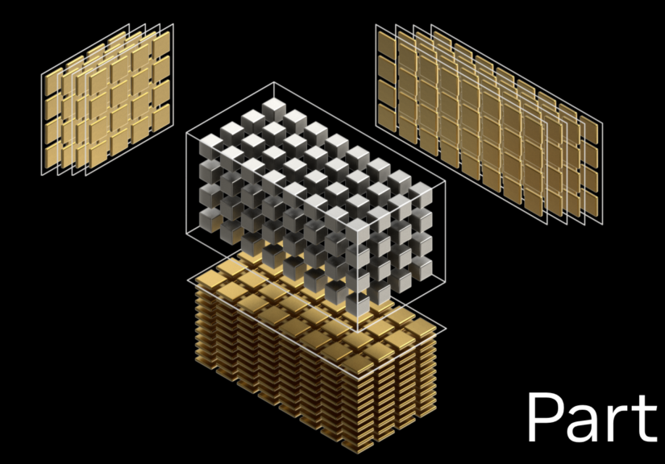
SESSION 01
WORKSHOP FEBRUARY 2026 BY DR CORONA-LOPEZ
INTRODUCTION TO
PYTORCH
FACULTY OF SCIENCE AND ENGINEERING
UNIVERSITY OF MANCHESTER

Slide 2

BY DR CORONA-LOPEZ
FEBRUARY 2026
AGENDA
pytorch fundamentals and advantages
working with tensors
tensor operations and manipulation
automatic differentiation (autograd)
moving from data to tensors
gpu acceleration
01

Slide 3
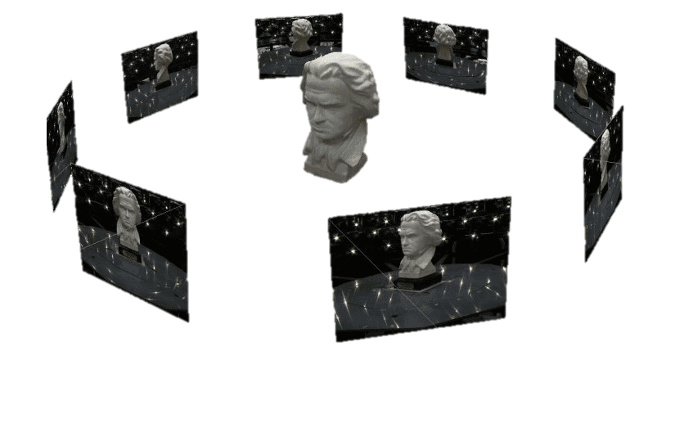
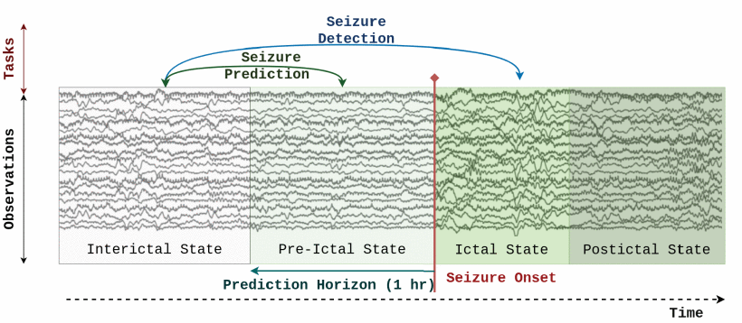
deep learning is a subset of machine learning where models learn directly from data. inspired by the structure and function of the human brain. just like humans learn to recognize cats by seeing many pictures of cats, deep learning models learn patterns from data — not rules programmed by hand.
02

Slide 4
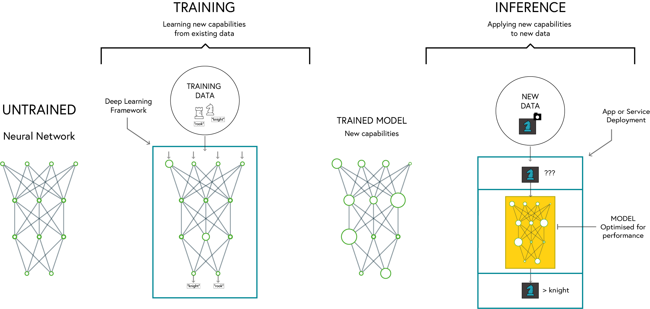
BY DR CORONA-LOPEZ
FEBRUARY 2026
DEEP LEARNING
03

Slide 5

PYTORCH
BY DR CORONA-LOPEZ
FEBRUARY 2026
dynamic computation graph
easier debugging and flexible model building
pythonic and intuitive api:
seamless integration with python libraries
strong research and industry adoption
used by major companies and researchers
excellent gpu acceleration
optimised for performance on gpus and tpus
04

Slide 6
WHY PYTORCH
BY DR CORONA-LOPEZ
FEBRUARY 2026
FEATURE | PYTORCH | TENSORFLOW | KERAS
EASE OF USE | high (pythonic, dynamic computation graph) | moderate (static graph by default, more setup) | very high (high-level api)
FLEXIBILITY | high | moderate | low (abstracted api)
PERFORMANCE | high | very high (optimized for deployment) | moderate
DEBUGGING | easy (eager execution) | harder (graph-based execution) | easy
GPU SUPPORT | excellent | excellent | good
INDUSTRY USE | research, prototyping | production, deployment | rapid prototyping
05

Slide 7
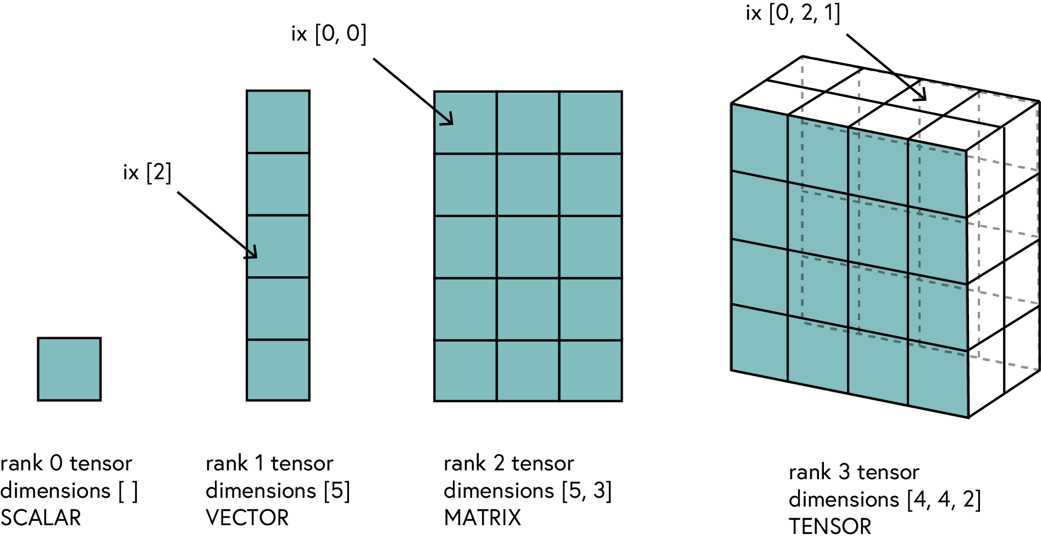
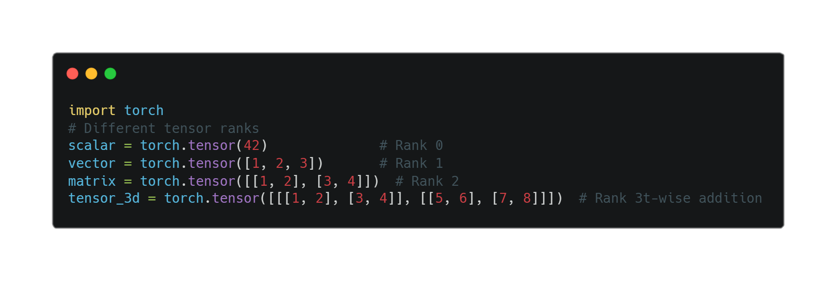
BY DR CORONA-LOPEZ
FEBRUARY 2026
TENSORS
definition: a generalization of vectors and matrices to higher dimensions
why tensors?
efficient representation of
multi-dimensional data
optimized for computation (cpu & gpu)
06

Slide 8
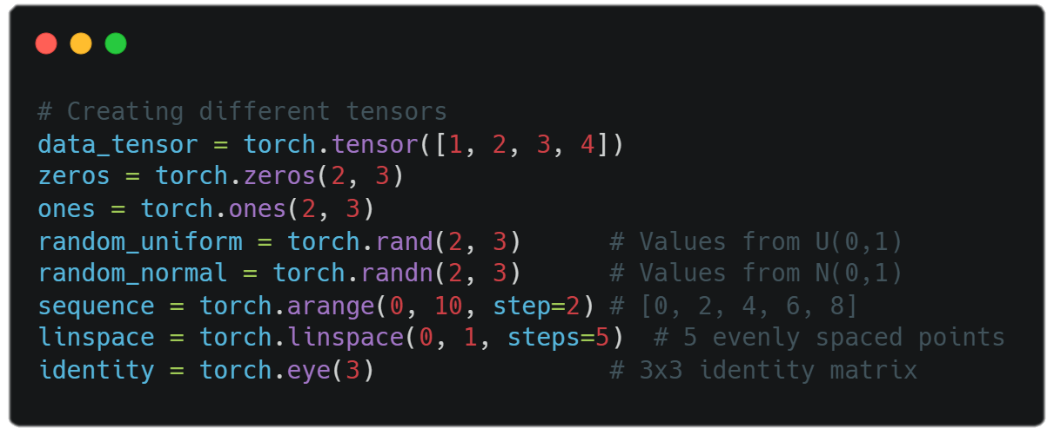
BY DR CORONA-LOPEZ
FEBRUARY 2026
CREATINGTENSORS
torch.tensor() -> from existing data
torch.zeros(), torch.ones() -> filled tensors
torch.rand(), torch.randn() -> random tensors
torch.arange(), torch.linspace() -> sequences
torch.eye() -> identity matrices
data types can be specified with dtype parameter
07

Slide 9
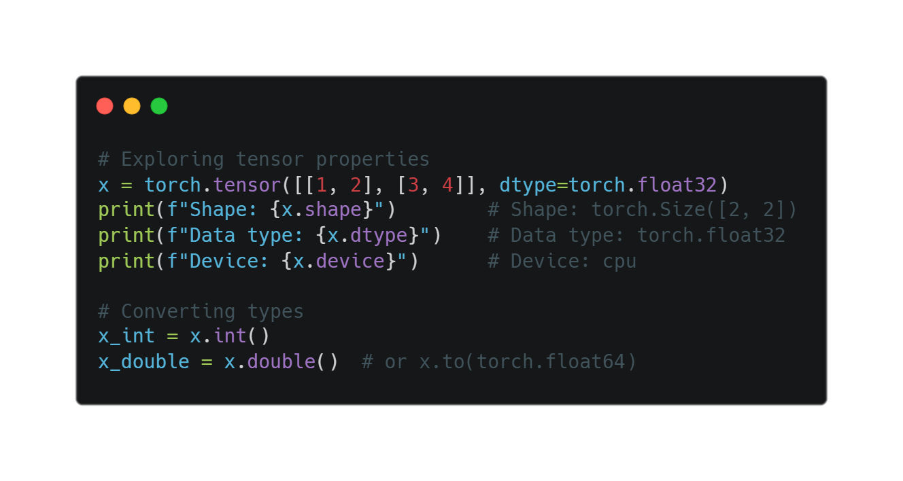
BY DR CORONA-LOPEZ
FEBRUARY 2026
TENSOR PROPERTIES
working with tensor attributes
shape: tensor.shape
data type: tensor.dtype
device: tensor.device
accessing values:
tensor.item() for scalars
converting types:
tensor.float(), tensor.int()
08

Slide 10
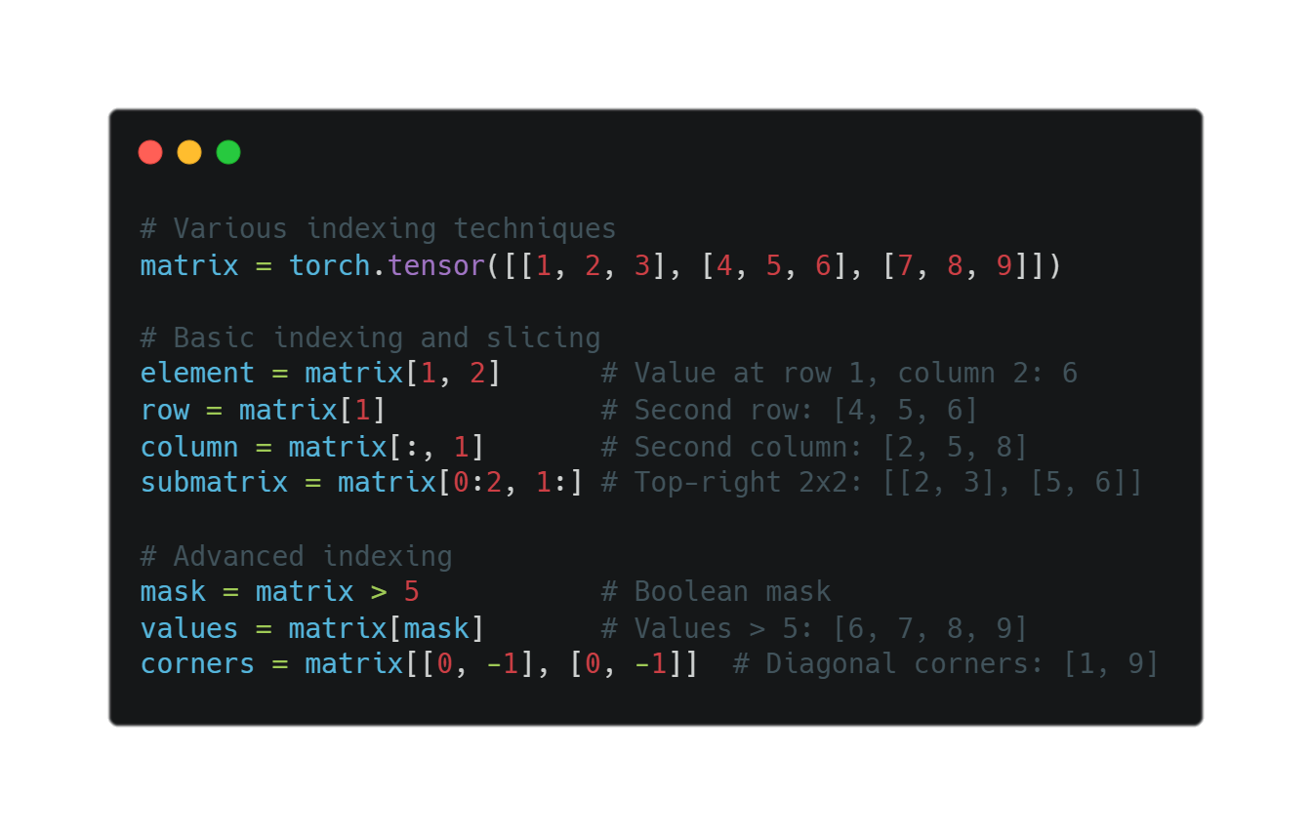
BY DR CORONA-LOPEZ
FEBRUARY 2026
TENSOR INDEXING
accessing tensor data
basic indexing: tensor[i, j]
slicing: tensor[1:3]
boolean masks: tensor[tensor > 0]
negative indexing:
tensor[-1] (last element)
using ellipsis: tensor[..., 0]
09

Slide 11
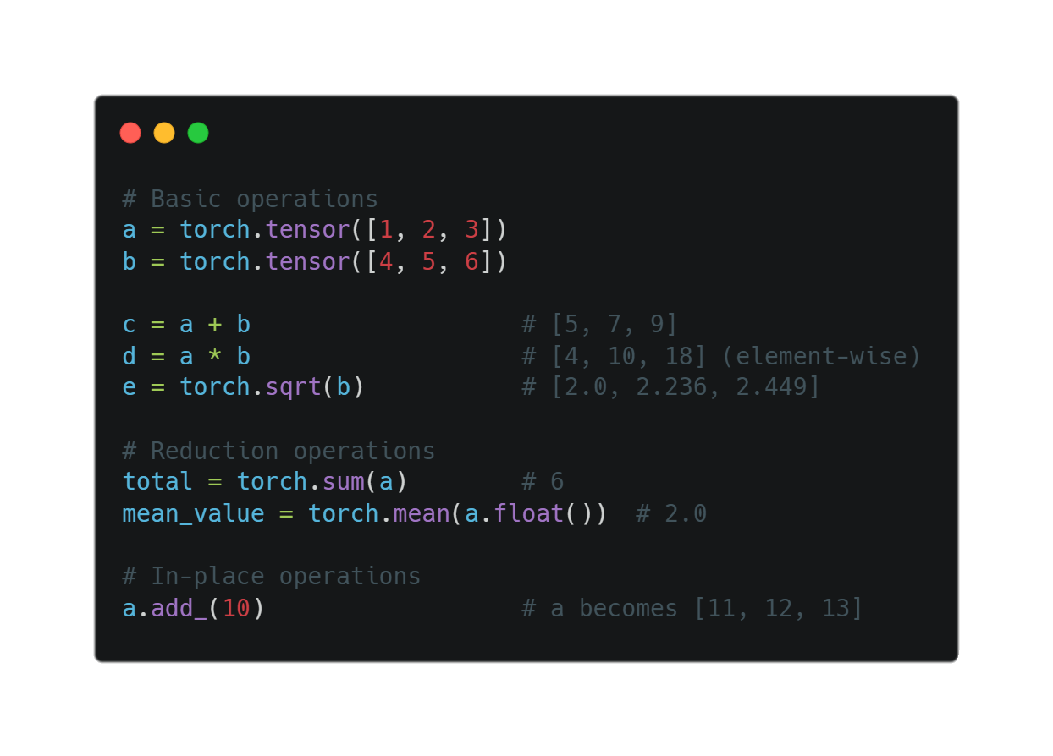
BY DR CORONA-LOPEZ
FEBRUARY 2026
TENSOR OPERATIONS
Common Operations
Arithmetic: +, -, *, /
Element-wise operations:
torch.sqrt(), torch.pow()
Reduction: torch.sum(), torch.mean()
Comparisons: >, <, ==
In-place operations:
tensor.add_(1) (note the underscore)
10

Slide 12
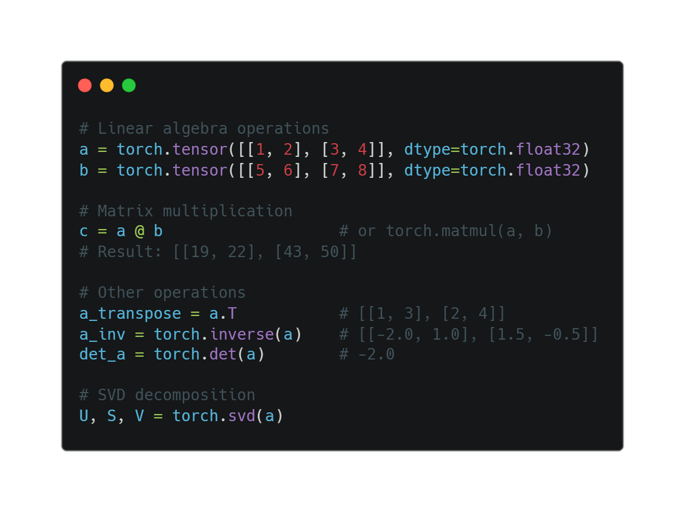
BY DR CORONA-LOPEZ
FEBRUARY 2026
MATRIX OPERATIONS
linear algebra with pytorch
matrix multiplication:
@ or torch.matmul()
transposition: .T or torch.transpose()
inverse: torch.inverse()
determinant: torch.det()
eigenvalues: torch.eig()
svd: torch.svd()
11

Slide 13
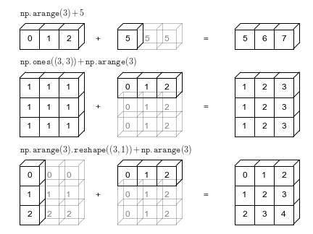
BY DR CORONA-LOPEZ
FEBRUARY 2026
BROADCASTING
working with different shapes
automatic expansion of smaller tensors
rules follow numpy broadcasting
eliminates need for explicit reshaping
examples:
add scalar to matrix
multiply matrix by row/column vector
scale batches of data
12

Slide 14
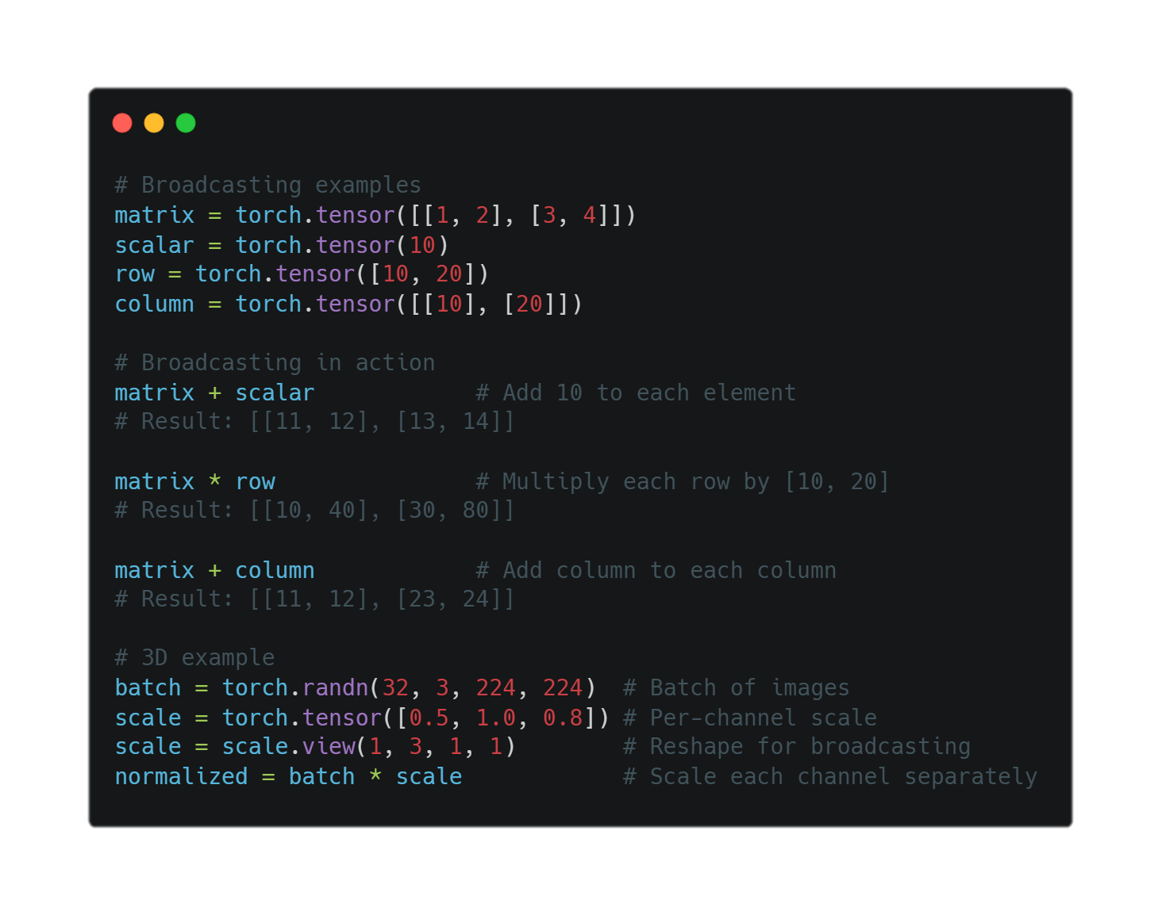
BY DR CORONA-LOPEZ
FEBRUARY 2026
BROADCASTING
working with different shapes
automatic expansion of smaller tensors
rules follow numpy broadcasting
eliminates need for explicit reshaping
examples:
add scalar to matrix
multiply matrix by row/column vector
scale batches of data
13

Slide 15
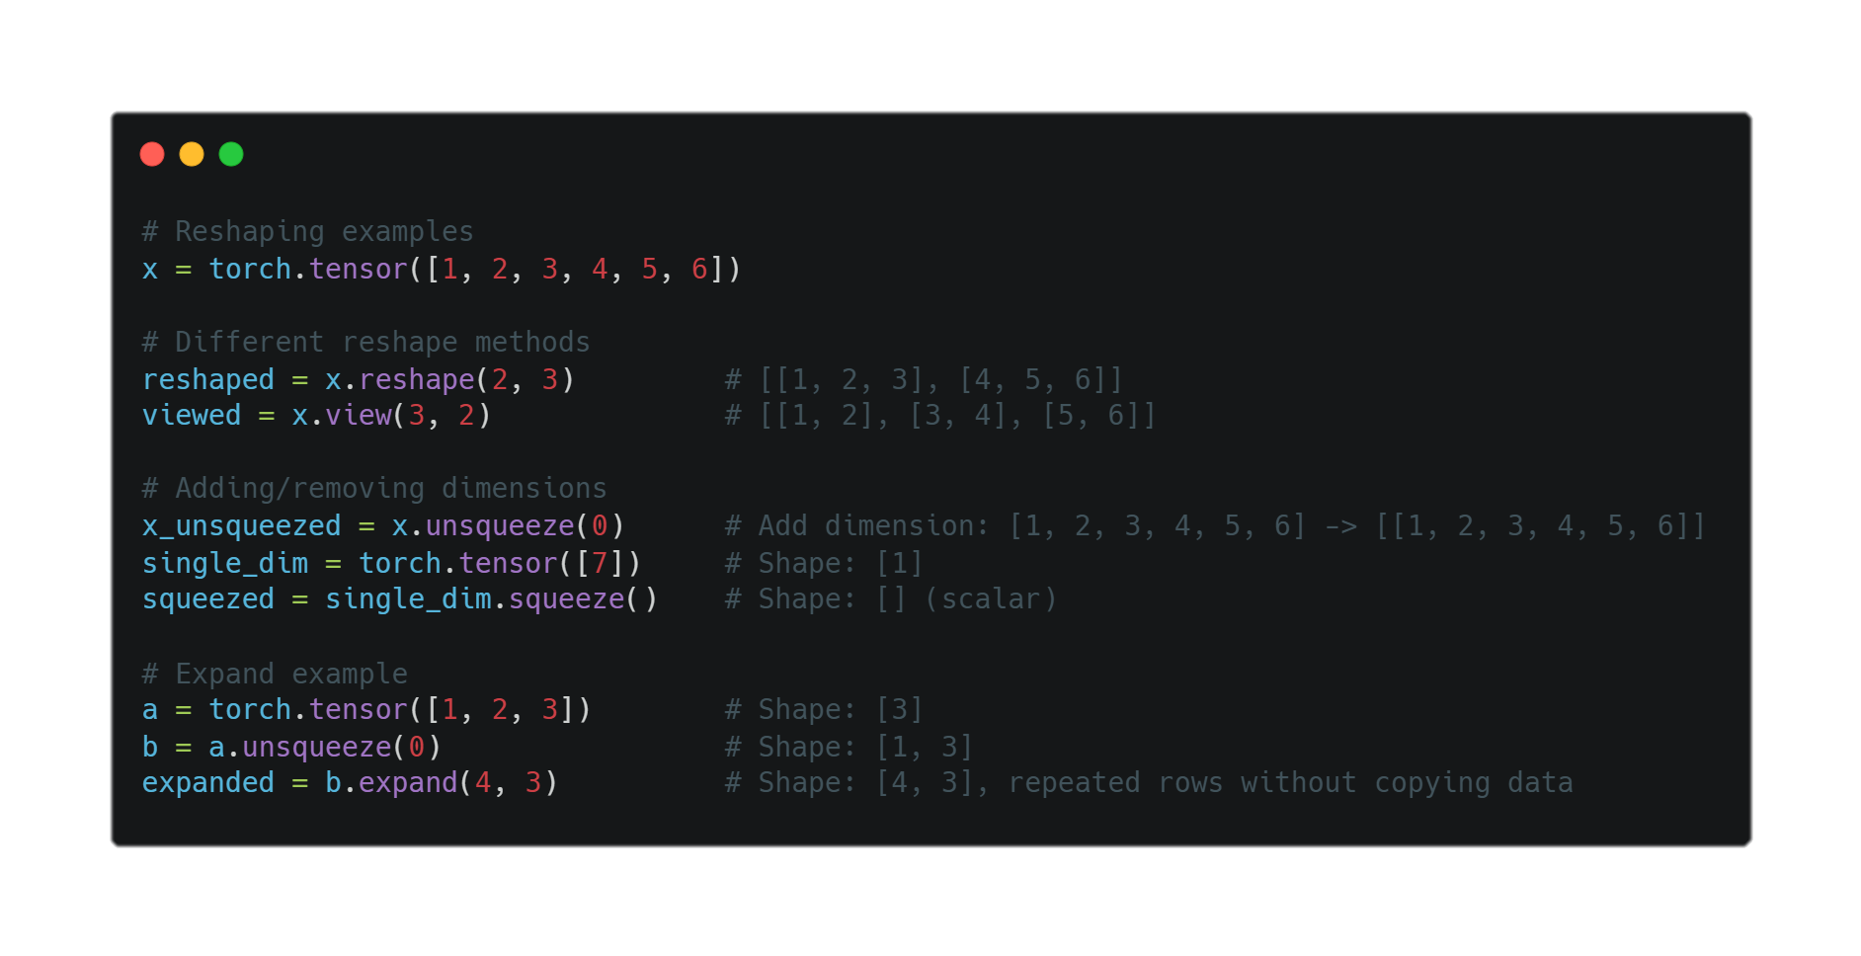
BY DR CORONA-LOPEZ
FEBRUARY 2026
RESHAPING
changing tensor dimensions
reshape() - new shape, possibly new memory
view() - new shape, same memory (must be contiguous)
squeeze() - remove dimensions of size 1
unsqueeze() - add dimension of size 1
expand() - broadcast dimensions without copying
14

Slide 16
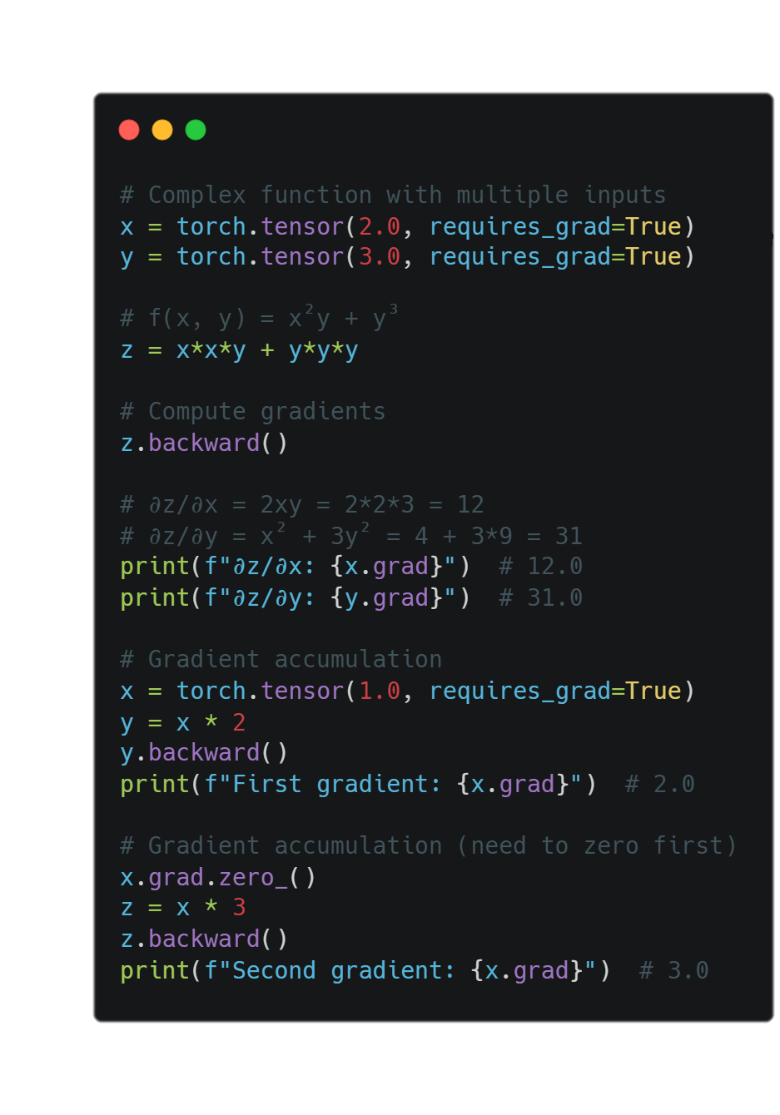
BY DR CORONA-LOPEZ
FEBRUARY 2026
AUTOGRAD
computing gradients
enable tracking with requires_grad=True
build computation graph through operations
call backward() to compute gradients
access gradients via tensor.grad
15

Slide 17
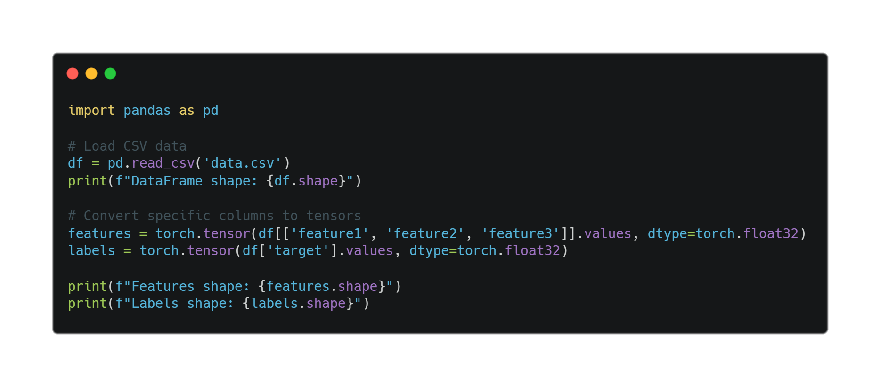
BY DR CORONA-LOPEZ
FEBRUARY 2026
LOADING
DATA
raw data to tensors
common data sources: csv, images, text
converting pandas frames to tensors:
df = pd.read_csv('data.csv')
tensor = torch.tensor(df.values)
16

Slide 18
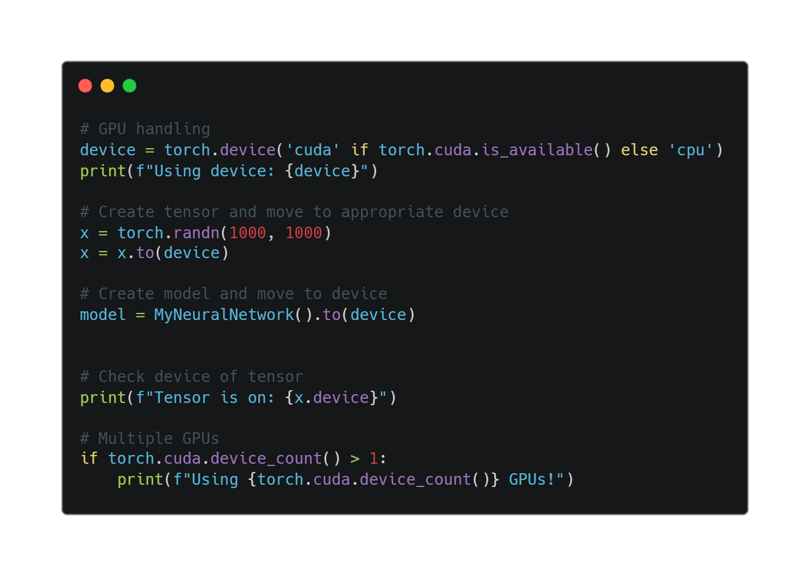
BY DR CORONA-LOPEZ
FEBRUARY 2026
GPU
leveraging hardware
check availability: torch.cuda.is_available()
select device:
device = torch.device('cuda')
move tensors to device:
tensor = tensor.to(device)
when to use gpu:
large tensors/datasets
computationally expensive operations
deep learning model training
keep all tensors on same device for efficiency
17

